Slide 1


Multi-Dimensional Conversation Analysis Pipeline and Batch load plan

Slide 2
Agenda
Overview of Definity needs.
Necessary implementation of a rolling window to maintain a manageable amount of data for active model analysis
Additional performance tuning updates planned to support day to day runs for regular Hourly multi dimensional insight availability. 2600 conversations/day.
Suggestions for optimised batch loading process of insight from 9M DP across 220k conversations.

Slide 3
Known data shape numbers
As of 2024-11-20 there were about 30k calls and chats ingested for data load from production. This is likely the most representative sample to date of the data shape.
23,809 calls between 19 June 2024 and 8 July 2024
Average HF datapoints 39.4
Min 2
Max 868
9,255 chats between 19 June 2024 and 6 August 2024
Average HF datapoints 37.7
Min 1
Max 243
For simplicity an overall average of 40 is used for calculations on effort here

Slide 4
Overview of Definity day to day
Definity want to maintain dashboards of insight for approximately 2,600 calls per day, across CHAT and PHONE, across two business units Sonnet and NBS
These incorporate a wide variety of call types including outbound calls, inbound calls, and calls between end customers and agents, brokers and agents and agents and senior agents.
Each business unit has different business requirements and each call type requires different contextual setup in the LLM to produce high quality analysis
There are then 5 dimensions of analysis across 4 reports which Definity want to maintain across this call set.
Dimensions of analysis may have multiple workspaces…

Slide 5
Needs for day to day running
Fast end to end turn around of a process from ingestion from big query through to insight returned to big query to support regularly updated dashboards
Data freshness requirement in d2d is Hourly small batch sizes for this to occur
Easy to manage conversation set which users can understand in the tool to maintain the models
Multiple workspaces which filter and select only certain calls for pipeline processing given various criteria.
Multiple pipelines with tuned prompts for different business units and call scenarios.
For some dimensions NLU model taxonomies to summarise the data into useful groups for visualisation after BigQuery

Slide 6
Dimensions of analysis
Topic (INTENT)
what was the topic causing the analysed party to call
Topic (REASON)
what was the reason that the analysed party could not do this through self server
FAQs inferred
what FAQs can be inferred from this call that might have deflected the call
Escalation
if this call is escalated to another more senior agent - why does this happen
Callback
if this call is a callback why is the callback necessary

Slide 7
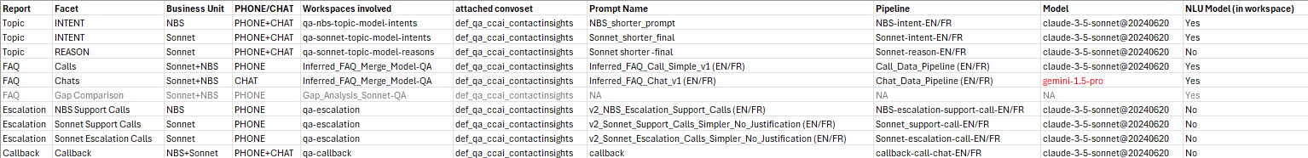
More complicated than that:
Key numbers:
6 workspaces per convoset
9 pipelines per convoset
Covers varying selection criteria of Phone, Chat, NBS, Sonnet, which varies by report.
Topic report pipelines is every call, other pipelines subsets of some description, but leading to analysis of almost every

Slide 8
What observed in first joint testing
Sessions Tuesday 12th and Thursday 14th November
2h 7m and 2h 30m to perform a single file analysis due to low end to end understanding of the system by any user.
No user able to operate all steps to conduct realistic testing.
Some steps display slower than expected running as file numbers grow.
Some steps displayed retries which were not expected to be necessary.
Testing was conducted on only a single dimension being attempted sequentially
However multiple dimensions were connected to the data set
Later on it is expected that dimensions of analysis may be running in parallel.
There was no management of the active data volume (using for instance a rolling window) and the number of files was large.

Slide 9
Batch load background
Definity are expecting reports to contain data from June 19th 2024.
Ingestion from Five9 into BigQuery has started.
The total volume of expected data to be historically loaded is expected to be ~9M datapoints across 220k calls, across 6 dimensions of analysis with 9 pipelines.
The assumed approach was to run each dimension as they were signed off by the business across a very large rolling window of data using the day to day process with small batch sizes as fast as possible
This will not be successful because - it would need an actively managed set of data across all reports in the region of of 9M datapoints.
The batch sizes are tuned for day to day running and generate an enormous amount of unnecessary updates across all the indexes, workspaces, etc involved

Slide 10
Recommended Actions
Implement the already planned next sprint rolling window to manage the data volumes to a configurable value (10 files suggested initially and work up)
Tolerate longer data readiness delays after pipeline completion
Humanfirst will continue to deliver a set of improvements aimed at speeding and smoothing the day to day running - this will allow increasing the rolling window duration for day to day operation.
Make a plan for how to do the batch load for each report in an efficient dedicated manner using the most of the existing solution possible
Notes:
Removed: Between pipeline finish and downloading the insight implement a short wait (120s suggested to allow index to be in place and remove unnecessary retries and confusion - note release on XYZ makes this not necessary
OK - but have been chasing them previously to make this - so will need to wokr out whether they already have or not.

Slide 11
Agreed approach before detail?
?

Slide 12
Day to day running improvements

Slide 13
Improvements D2D batch 1
Search service: lazily download new indices (PB-8139)
Dataset was linked to 8 different workspaces (now reduced to 6 by tidy p) , resulting in 8x indices to be recreated and downloaded by our search service on every file upload (resulting in up to ~70-80GB to be redownloaded) - this should result in an 8x speedup for data readiness
This tweaks the way we download indices by lazily downloading indices on search requests
For this reason, contrarily to what we had previously mentioned, you should call the export endpoint as soon as the pipeline has succeeded
Expected release: 1.65 (around Nov 21th)

Slide 14
Improvements D2D batch 2
Fixes for failing / non-progressing pipeline triggers (PB-8095, PB-8111)
Prevent triggers (on file upload/delete and on pipeline generation) from stalling because of failing dependencies. This should either run if the dependency is not critical, or fail instantaneously with proper error reporting.
Fix for the “worked died while executing task” error encountered previously
Ability to upload files with “no_trigger” to upload many and then have the index built once. (PB-8157)
Allow efficient upload of large numbers of small files
Be able to delete a file and upload a file with a single index update
Expected release: 1.65.1 (around Nov 28th)

Slide 15
Improvements D2D batch 3
Speed improvement in generation pipeline with prompt referencing whole conversations
Better batching in prompt rendering (PB-8112)
Gate unused embedding metrics (PB-8163)
UI improvements for index readiness
Fix the issue where the data view was not refreshing when the index was ready (PB-8110)
Indicate when the queried index is not the latest (as the newly created one is being downloaded) (PB-8110)
Expected release: 1.66 (around Dec 6th)

Slide 16
Improvements D2D batch 4
Improve our pipeline incrementality & resiliency
Better incremental indexation (PB-8175)
Better incremental generation pipeline (PB-8180)
Make generation cache more crash-resistant (PB-8162)
Generate pipeline prompt rurun parameter (PB-8181)
Expected release: 1.67 (around Dec 20th)

Slide 17
Other options can investigate
Improvements to GUI to make download indexes waits more obvious with a progress counter where they still occur
For APIs options to swap to endpoints which provide expected download duration to allow waits to be predicted not polled for
Expected release: TBD

Slide 18
Batch Process

Slide 19
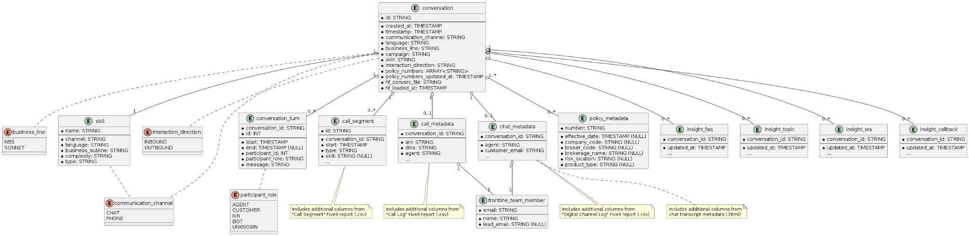
Tables involved in BigQuery
Tables to left of here can be assumed to be filled by configuration or ingestion from Five9 - they represent data in that has started. The four tables to the right of this are filled by some combination of pipelines from HumanFirst and need to have a large volume of data loaded and then continuously maintained. “Insight” tables

Slide 20
Key options to batch load successfully
Release all reports to production as a unit and move as a coordinated unit through a historical period until current date with a single rolling window of active data in HF
Dataload individual reports in isolation in an optimised process, then have them join a single window that keeps them up to date.

Slide 21
Other options not investigated in detail
Multiple convosets per report
Quadruples overall datapoints
Multiple reloads with 1, 2, 3 then 4 reports using a rolling window through the data.
Multiplies total work to be done by 4.
Interrupts running four times

Slide 22
Release all reports as a single release
Pros
Reuses single process
Cons
Doesn’t provide incremental milestone wins for project
Will involve a large delay to the first data in prod people see.
Still faces very large duration issues with the dataload
Dataload size will become worse with delay and may not be able to addressed by this method at all leading to a truncated data load size.

Slide 23
Why is the D2D process is not a good choice for batch runs.
Many dimensions are analysis are being updated every file when only one dimension is required for each to be loaded.
Data is very frequently being refreshed for active analysis during the load that will never actually be investigated until the load is finished.
Batch sizes are small and frequent optimized for frequent regular updates in D2D running and not for large data loading
The overall duration of running with D2D sized loads compared to Batch loading is likely to be ~900x slower than an optimized batch process

Slide 24
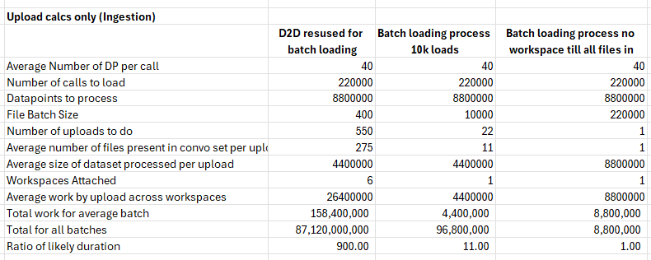
Example Duration Comparison

Slide 25
Suggestion - column 3
Create dedicated batch load conversation set per report
Load all files into it before attaching.
Only attach one dimension of analysis prior to go live - only one index update.
Run pipeline in file batches of ~10k (or some large number) not 400 - this is limited only by LLM failure and rollback time.
Indexes only updated after each pipeline batch and allow monitoring and checking of process
High efficiency data generation and load
When insight fully generated attach to the rolling window and continue to update with small regular batches.

Slide 26
Thank you

